Slide 1

Welcome to CodingJobs S2 2022
27.09.22

Slide 2
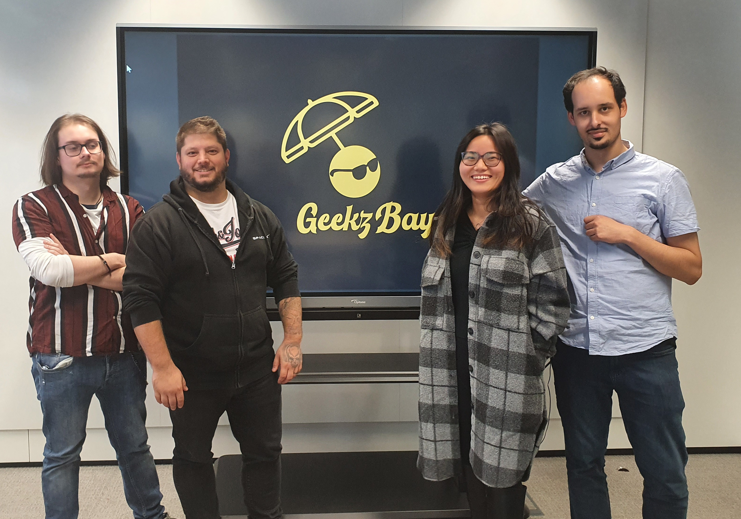
Our Team:
Fabio Portugal Neves || Yan D’Amelio
Hai Na Zheng || Amin Jean Bredimus

Slide 3
Tasks divided in the team:
Hai Na:
register, login, email verification, remember/reset/forget password, discord authentication
Find random buddy
My buddies
My communities
My-locations
My profile
Bootstrap
Routes building and management
Bug Fixing
Database building
API Routing
Github management
Amin:
API
Position Stack fetching
Query Saving functionality
Meetup Page and Meetup details
Location Page
Styling skeletons (Bootstrap)
Bug Fixing
Database Design
Yan:
Project management
Project PowerPoint
My-Meetup Page
Styling skeletons
Homepage
Database support
Seeders
Models
Controllers
Bug Fixing
Communities Page skeleton
Meetup Page skeleton
Discord Server for the Group
Fabio:
CSS Styling
Bootstrap
Logo design
Webpage colour set
Front-End Design
Database support
Seeders

Slide 4
Our Goals:
Create a platform to spotlight the community of Geeks and Gamers from Luxembourg
Be the first entry point in search results for Geeks and Gamers in Luxembourg
Build a strong Community with different Interests

Slide 5
Features:
Gamers and Geeks can meet each other
1
Find Information about coming Events
2
Find Shops and Locations
3
Build a connection via Discord
4

Slide 6



Tools used for:
Organisation:
Trello
GitHub
Coding text tech:
Visual Studio Code
HTML, CSS, Laravel, PHP, JavaScript, Bootstrap, AJAX and API
External API:
positionstack.com/API
GitHub

Slide 7
Code example:
{{-- Search form --}}
<form method="get" id="search-form" class="d-none">
@csrf
<div><label>Search an Event</label></div>
<div class="input-group"><input type="text" name="name" placeholder="Name" id="search-name-input">
</div>
<div><input type="date" name="date" id="search-start-date"></div>
<div><input type="date" name="date" id="search-end-date"></div>
<div>
<select name="location_id" id="location_search_id">
<option value="">All</option>
@foreach ($locations as $location)
<option value="{{ $location->id }}">{{ $location->name }}</option>
@endforeach
</select>
</div>
<div>
<select name="community_id" id="community_search_id">
<option value="">All</option>
@foreach ($communities as $community)
<option value="{{ $community->id }}">{{ $community->name }}</option>
@endforeach
</select>
</div>
<div class="mt-3">
<input type="submit" value="Search" id="searchInput">
</div>
</form>

Slide 8
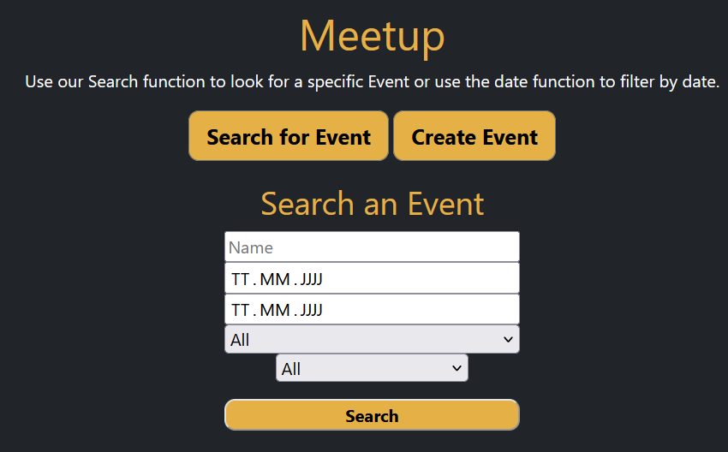
Output from the code example:

Slide 9
Issues and time time-eaters:
Issues implementing different features due to a big amount of relations
Starting point of the project: no clear point where to start as expectations were set to high
Issues with GitHub and management tools
Adding/deleting features and pages as everything started to merge together
Choosing the right design and colour set
Finding the right coding language

Slide 10

Any questions

Slide 11
Thank you for your time Enjoy the demonstration!

